Slide 1
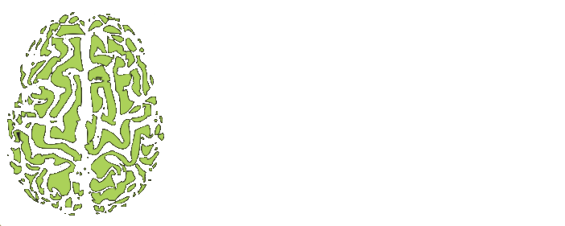
The Neural mechanism of Nature-based intervention with Environmental information of Forest
Chun Yi, Lee - Taiwan, NTU, 2023

Slide 2
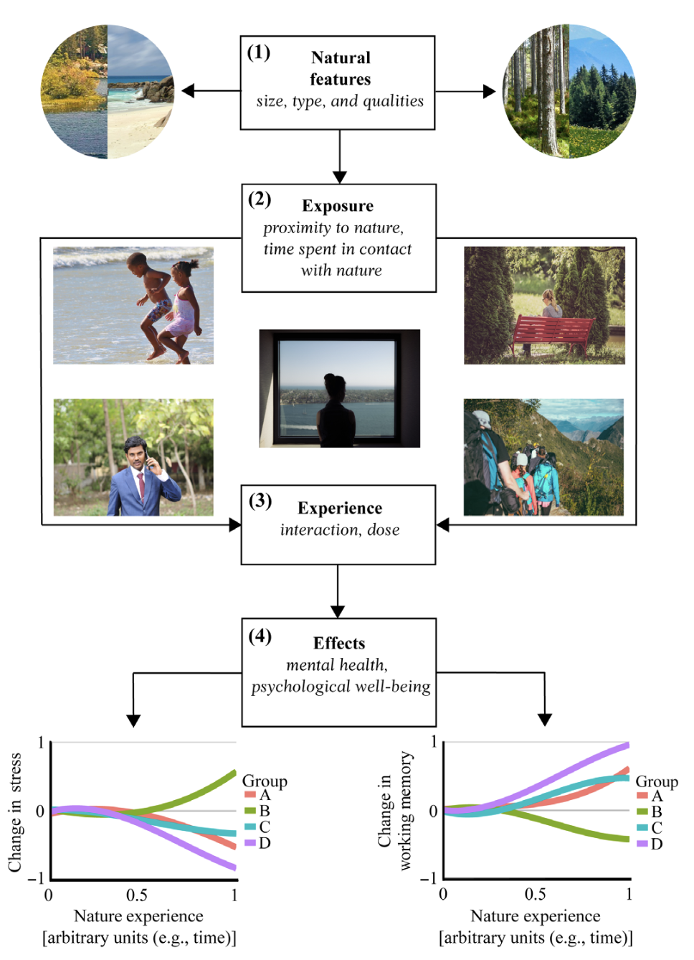
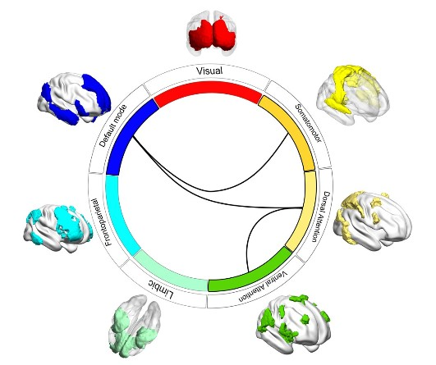
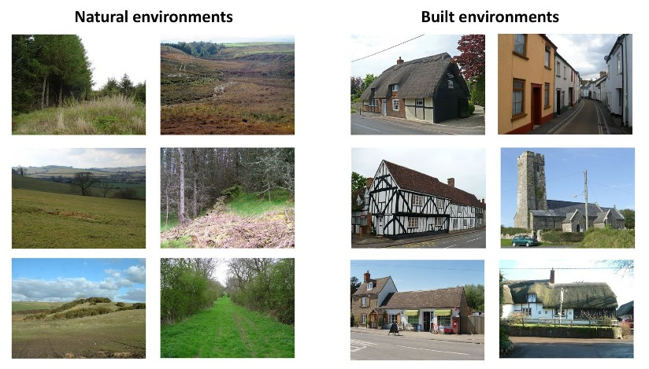
Background
Nature and mental health
Environmental preference
Brain functional connectivity

Slide 3
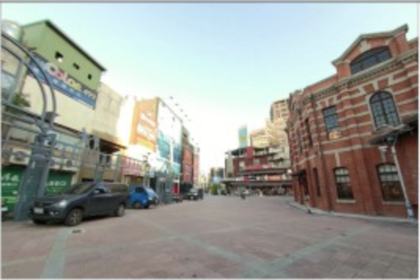
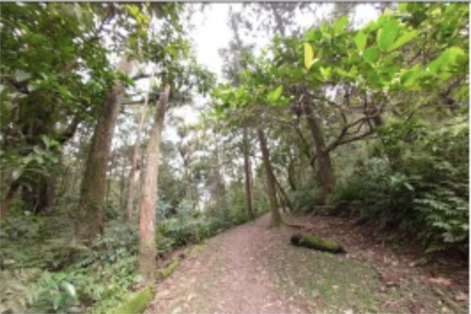
Objectives
How the neural process of nature environment and urban environment information in different individuals
Evaluate how the environmental information be processed in brain with Naturalistic Stimuli Paradigm
Identify the role of ventromedial prefrontal cortex (vmPFC) play in the environmental preference with Intersubject Correlation method
Explore whether the default mode network (DMN) can modulate the effect of nature-based intervention with Functional Alignment method
Urban video
visual cortex
More prediction error
More noise information in VMPFC
Slower alignment rate in DMN
Nature video
visual cortex
less prediction error
Less noise information in VMPFC
Faster alignment
rate in DMN

Slide 4
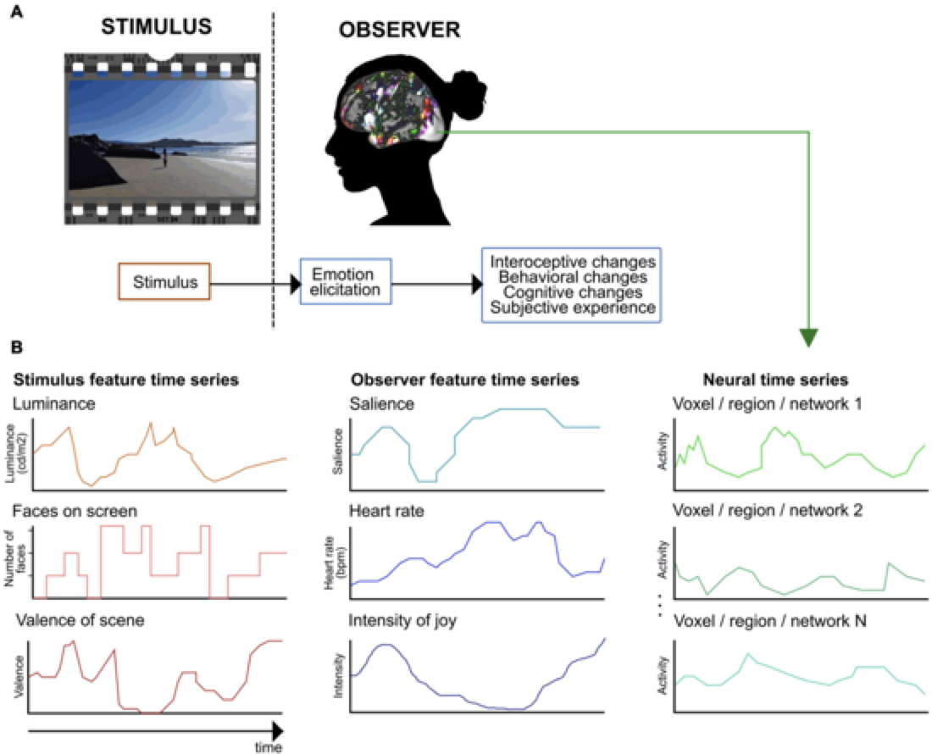
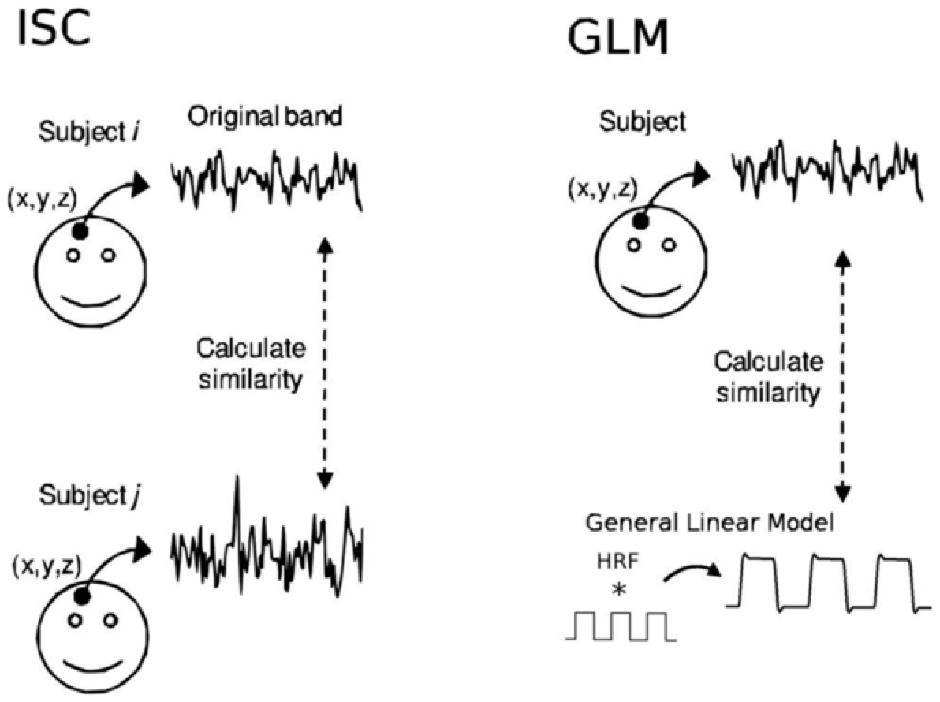
Data & Tools & Methods:
Data:
Location: Taiwan Mind & Brain Imaging Center at National Chengchi University
Participants: N = 60 (30 pro-nature, 30 pro-urban)
Stimulus: 10 min video with 5 scenes for both natural and urban environment
Naturalistic paradigms
Inter-Subject Correlation
Functional Alignment
Tools:
HeuDiConv for BIDS
fMRIPrep for preprocessing
Pliers package for automated feature extraction

Slide 5
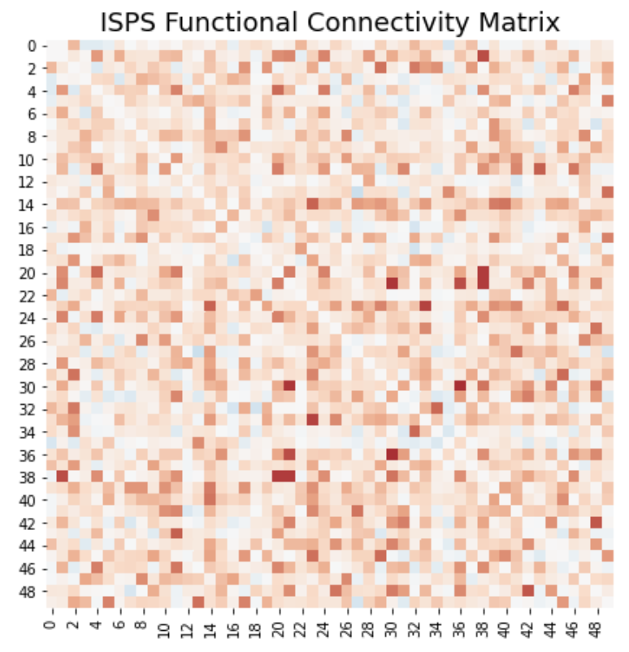
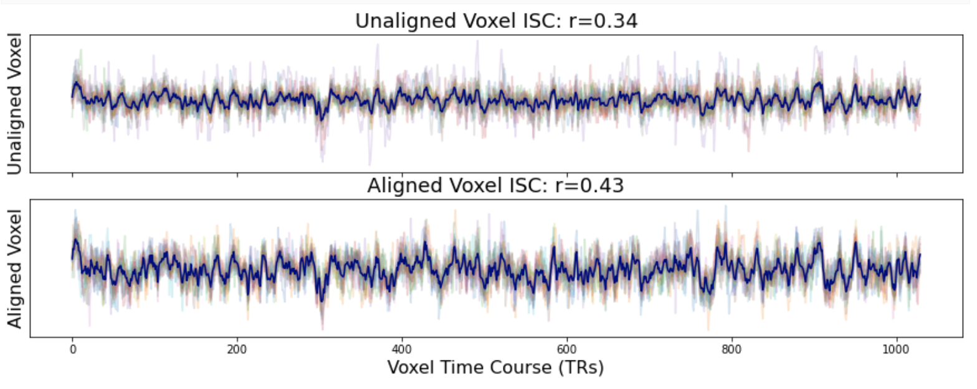
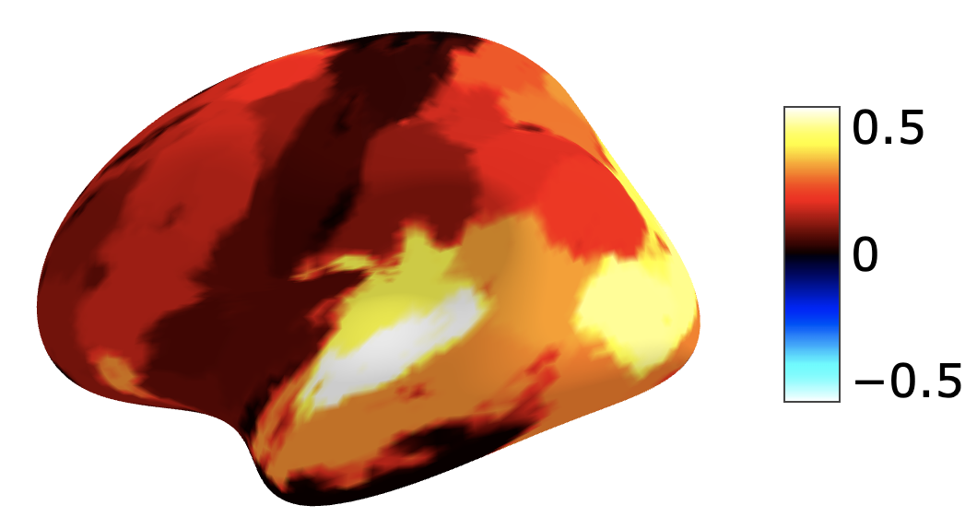
Results
Convert the raw dicom files into BIDS format by HeuDiConv tools
Create a container in server to isolate the process and manage packages
Preprocessed the nifti files with fMRIPrep as a Robust Preprocessing Pipeline for fMRI Data
Try to automated extract the features from environment stimuli with pliers package
Try to analyze the whole brain Intersubject Correlation and Functional Alignment between different participants with certain environmental preference
Demo

Slide 6
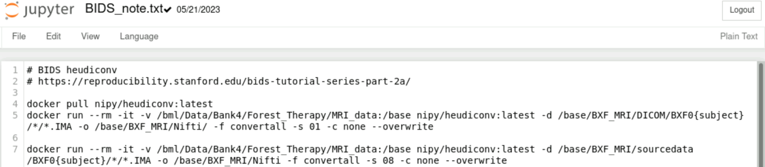
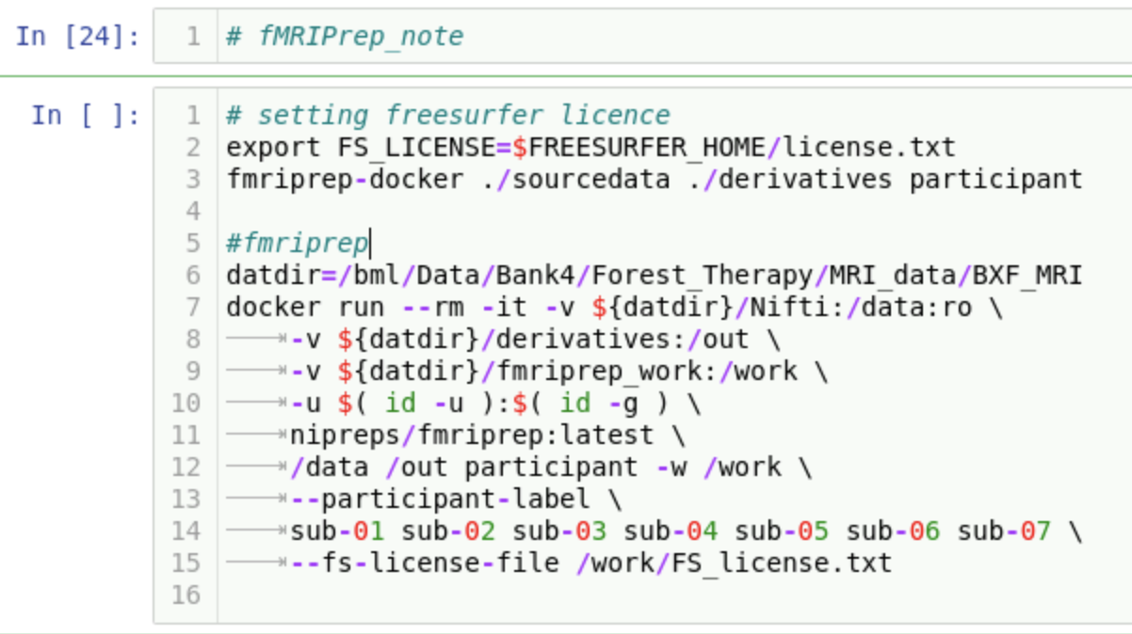
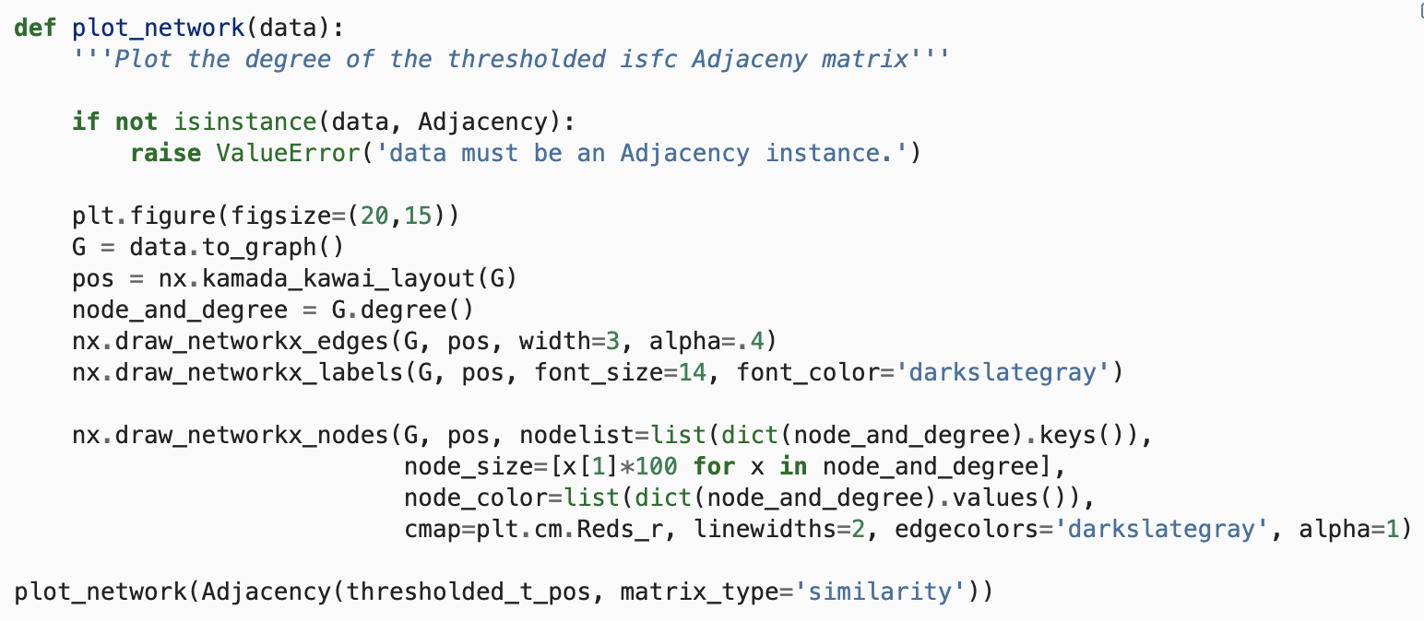
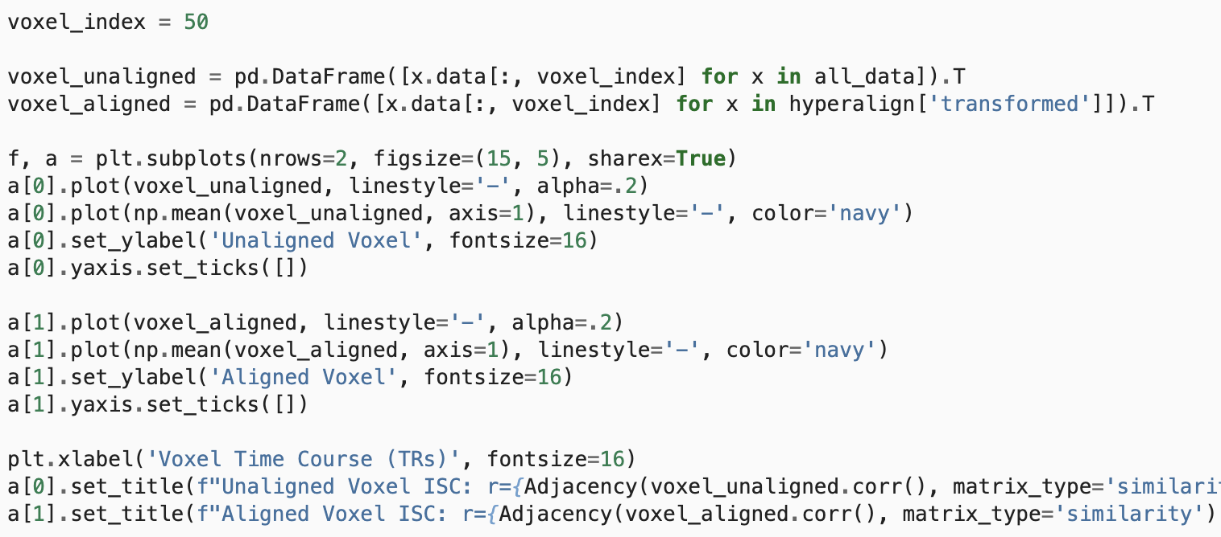
Deliverables
Analysis workflow
Code script

Slide 7
Conclusion
The challenges I encountered was the unfamiliar with python develop environment, especially the package management for python. The package management are relatively easy in R.
Made myself immerse in the python develop environment with tutorial provided by Brainhack or somewhere else. Trial and error, debugging and cross validation.

Slide 8
References
Repositories: https://github.com/JamesLeeCY/BXF_NDA.git
References:
Kuperman, V., Stadthagen-Gonzalez, H. & Brysbaert, M. Age-of-acquisition ratings for 30,000 English words. Behav Res 44, 978–990 (2012). https://doi.org/10.3758/s13428-012-0210-4
Warriner, A.B., Kuperman, V. & Brysbaert, M. Norms of valence, arousal, and dominance for 13,915 English lemmas. Behav Res 45, 1191–1207 (2013). https://doi.org/10.3758/s13428-012-0314-x
Glerean, E., Salmi, J., Lahnakoski, J. M., Jääskeläinen, I. P., and Sams, M. (2012). Functional Magnetic Resonance Imaging Phase Synchronization as a Measure of Dynamic Functional Connectivity. Brain Connect. 2, 91–101. doi:10.1089/brain.2011.0068.
Nastase, S. A., Gazzola, V., Hasson, U., & Keysers, C. (2019). Measuring shared responses across subjects using intersubject correlation. Social Cognitive and Affective Neuroscience, Volume 14, Issue 6, June 2019, Pages 667–685, https://doi.org/10.1093/scan/nsz037
Nummenmaa, L., Lahnakoski, J. M., and Glerean, E. (2018). Sharing the social world via intersubject neural synchronisation. Curr. Opin. Psychol. 24. doi:10.1016/j.copsyc.2018.02.021.
Simony, E., Honey, C. J., Chen, J., Lositsky, O., Yeshurun, Y., Wiesel, A., et al. (2016). Dynamic reconfiguration of the default mode network during narrative comprehension. Nat. Commun. 7. doi:10.1038/ncomms12141.

